Slide 1
Relational Data Model : Concepts
Data Base Management System

Slide 2
Relational Data Model
The model was first proposed by Dr. E.F. Codd of IBM Research in 1970 in the following paper: "A Relational Model for Large Shared Data Banks" Communications of the ACM, June 1970.
A Relation is a mathematical concept based on the idea of sets.
Relation : Collection of Rows and Columns.
Sets : Unordered collection of distinct elements.
Relational data model is the primary data model, which is used widely around the world for data storage and Data processing.

Slide 3
Relational Database
Relational Model represents how data is stored in Relational Databases.
A Relational Database is a collection of multiple interrelated Relations.
A relation is made up of two parts: Relation Instance and Relation Schema
A relational database has following other major components: 1. Table 2. Record/Tuple/Row 3. Field/Column/Attribute 4. Domain 7. Keys

Slide 4
Components
Tables (Relation) : A table is a collection of data represented in rows and columns. Each table has a name in database.
Tuple (Row/Record) : A single row of a table, which contains a single record for that relation is called a tuple. These rows in the table denote a real-world entity or relationship.
Attribute (Column/Field) : Attributes are a set of characteristics of the table.
Attribute domain : Each attribute has a set of valid values, known as attribute domain.
Key : Each row has one or more attributes which can identify the row in the relation (table) uniquely. Sometimes row-ids or sequential numbers are assigned as keys to identify the rows in a table Called artificial key or surrogate key.
Relation Schema : A Relation schema describes the Relation name, Attributes, and Attribute names.
Relation Instance : The data stored in Table at a particular moment of time is called Relation instance.

Slide 5
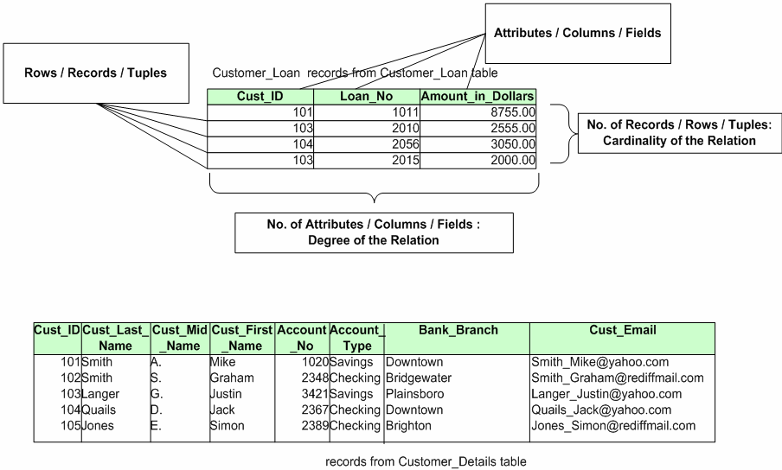
Table or Relation
In this Customer table, Cust_ID is the key.
The Total number of attributes in the relation = degree of the relation = 3
The Total number of tuples = Cardinality of this relation = 4

Slide 6
Relation Schema
A Relation schema describes the Relation name, Attributes, and Attribute names.
The Schema (or description) of a Relation: Denoted by R(A1, A2, .....An)
Where, R is the name of the relation
The attributes of the relation are A1, A2, ..., An
Degree (or arity) of a relation is the number of attributes n of its relation schema
E.g: CUSTOMER (Cust-id, Cust-name, Address, Phone_No,Gender)
Where, CUSTOMER is the relation name which is defined over the four attributes: Cust-id, Cust-name, Address, Phone_No
For example, the domain of Gender is {Male, Female}.

Slide 7
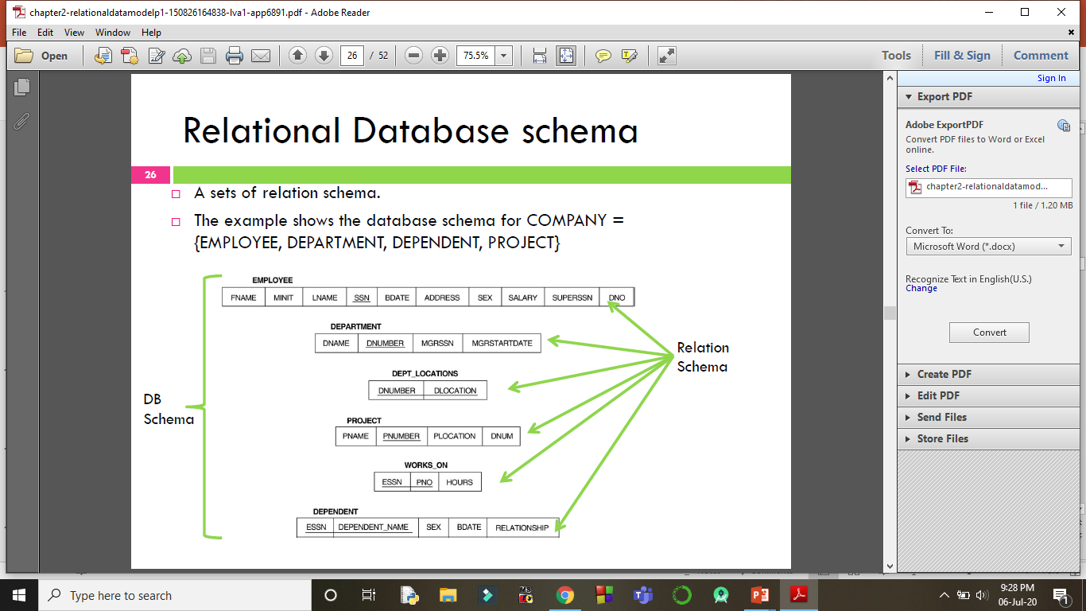

Slide 8
Relation Instance
A finite set of tuples in the relational database system represents relation instance.
The data stored in Table at a particular moment of time is called Relation instance.
The Relation Schema: Branch (BranchNo, Street, City, PostalCode )
The Relation Instance:
(B005, 55 Jln Dobi, Johor Bahru, 80100)
(B006, 55 Jalan Perai, Johor Bahru, 80000)
Relation instances do not have duplicate tuples.
The relation instance change when tuple is updated, deleted or inserted.

Slide 9
Codd’s Rule For RDBMS
Dr. Edgar Frank Codd, after his extensive research on the Relational Model of database systems, came up with 13 rules of his own, numbered from 0 to 12.
These rules are Theoretical basis for Relational Databases.
According to him, if a DBMS meets these rules, it can be called RDBMS.
But none of the database follows all these rules; but obeys to some extent.
For example, oracle follows only 8.5 Codd’s rules.

Slide 10
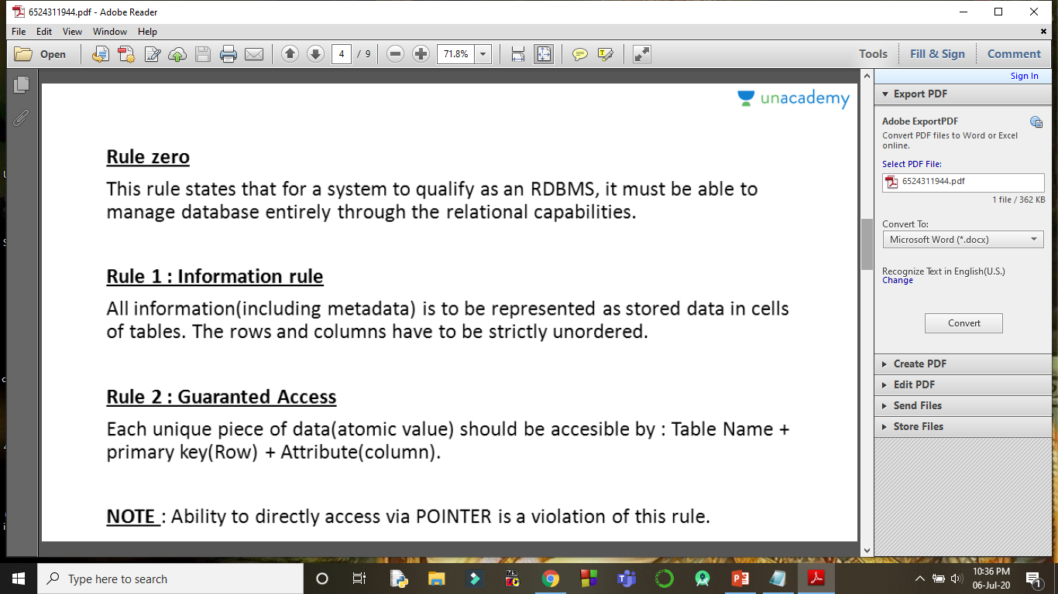
Other 12 Rules are derived from this Rule.
Consider a “Student” Relation-
Roll_No | Name | Age
201 | x | 10
202 | y | 12

Slide 11
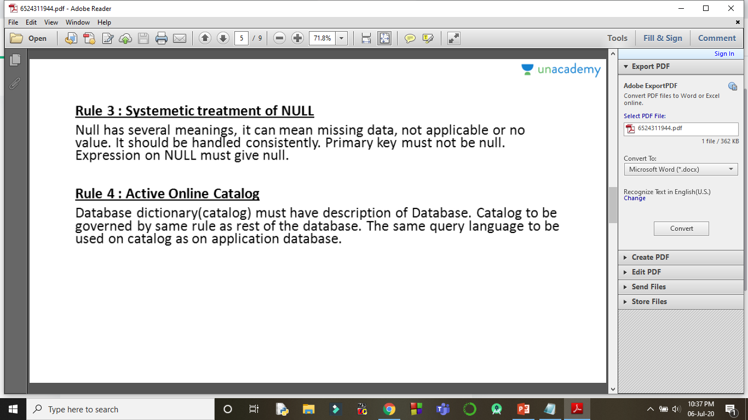
Student:
Roll_No | Name | Age
201 | x | 10
202 | y | 12

Slide 12
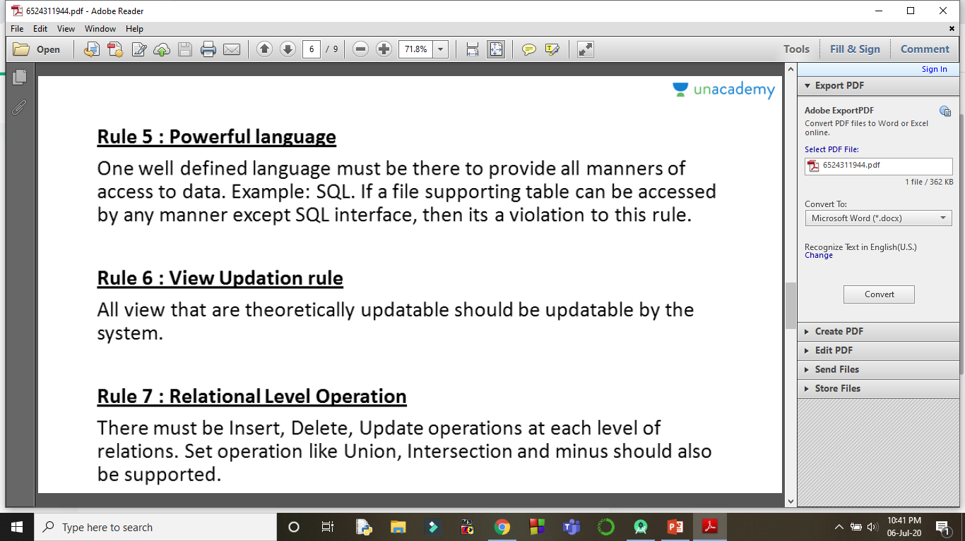
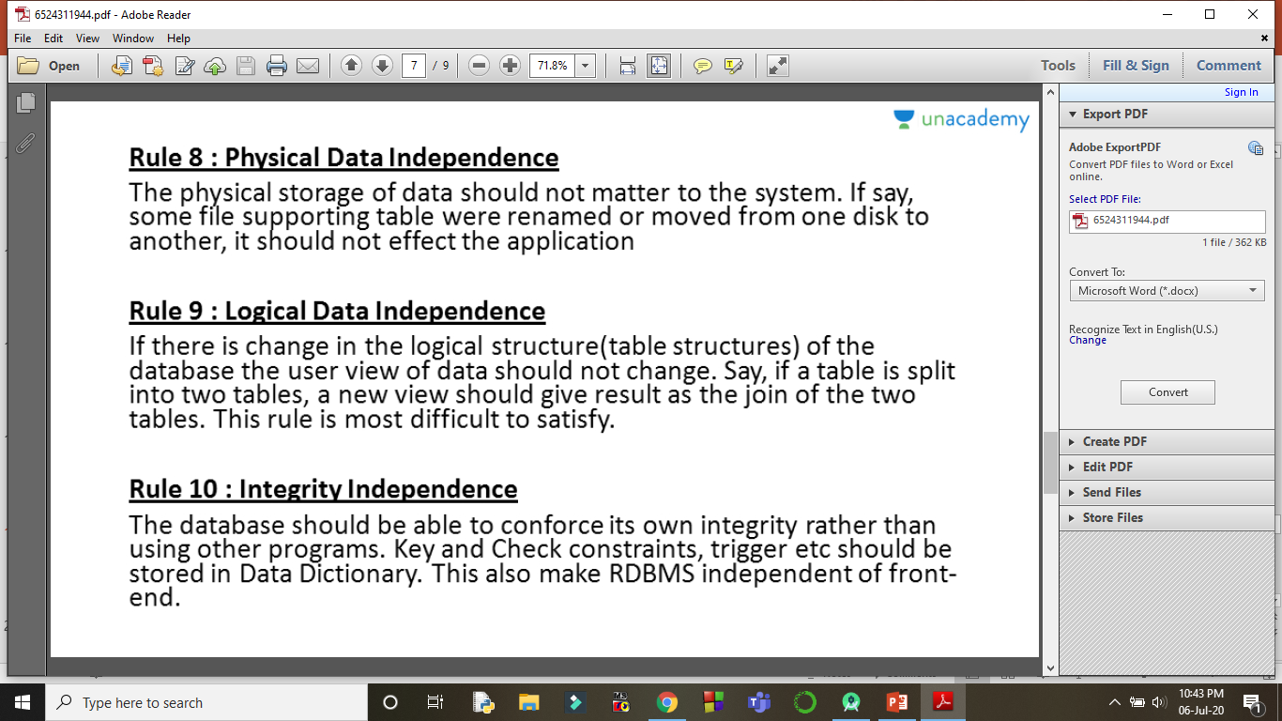

Slide 13
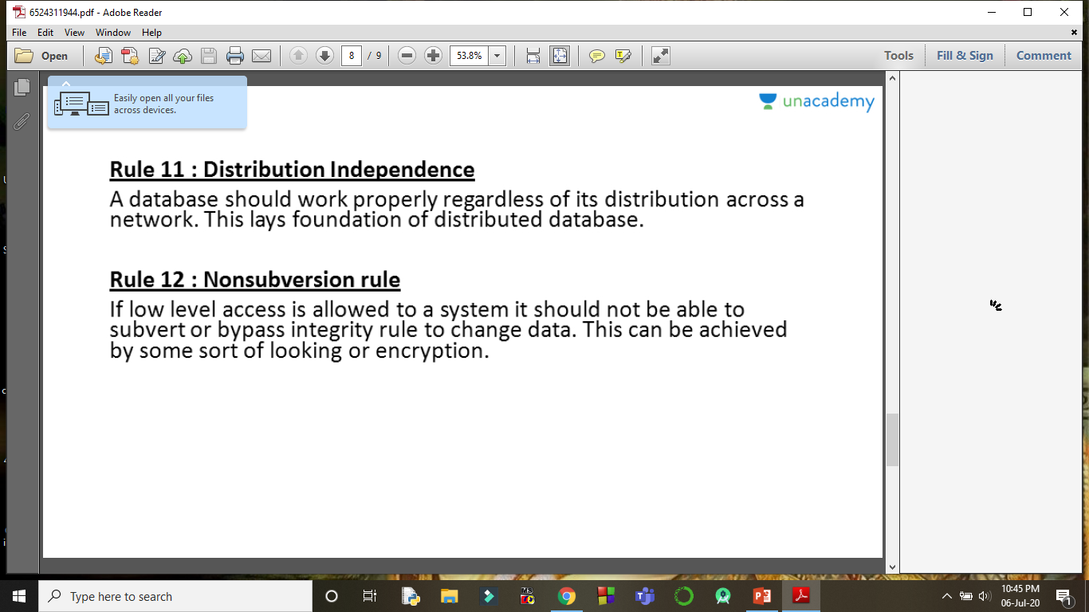

Slide 14
Difference Between DBMS and RDBMS
DBMS is a software that is used to define, create and maintain a database and provides controlled access to the data and RDBMS is an advanced version of a DBMS.
Database Management System (DBMS) | Relational Database Management System (RDBMS)
DBMS stores data as file. | RDBMS stores data in tabular form.
Data elements need to access individually. | Multiple data elements can be accessed at the same time.
No relationship between data. | Data is stored in the form of tables which are related to each other.
Normalization is not present. | Normalization is present.
DBMS does not support distributed database. | RDBMS supports distributed database.
It stores data in either a navigational or hierarchical form. | It uses a tabular structure where the headers are the column names, and the rows contain corresponding values.
It deals with small quantity of data. | It deals with large amount of data.

Slide 15
Database Management System (DBMS) | Relational Database Management System (RDBMS)
Data redundancy is common in this model. | Keys and indexes do not allow Data redundancy.
It is used for small organization and deal with small data. | It is used to handle large amount of data.
It supports single user. | It supports multiple users.
Data fetching is slower for the large amount of data. | Data fetching is fast because of relational approach.
The data in a DBMS is subject to low security levels with regards to data manipulation. | There exists multiple levels of data security in a RDBMS.
Low software and hardware necessities. | Higher software and hardware necessities.
Examples: XML, Microsoft Access, etc. | Examples: MySQL, PostgreSQL, SQL Server, Oracle, etc.

Slide 16
Constraints in Relational Model
Integrity Constraint
Entity Integrity Constraints
Referential Integrity Constraints
Domain Constraints
Key Constraints
References

Slide 17
Integrity Constraints
Every relation has some conditions that must hold for it to be a valid relation.
These conditions are called Constraints.
Conditions that can be applied to the database schema to restrict the data according to the need.
Relational constraints are the restrictions imposed on the database contents and operations.

Slide 18
Purpose Of Integrity Constraints
To ensure the correctness of data in the database.
To ensure that there should not be any loss in data consistency due to changes made to the database by authorized users.
These constraints are checked before performing any operation (insertion, deletion and updation) in database. If there is a violation in any of constraints, operation will fail.

Slide 19
Entity Integrity Constraints
No two entities can have the same name.
There should not be any duplicate rows within the a relation.
No attribute of primary key must contain a null value in any relation. This is because the presence of null value in the primary key violates the uniqueness property.

Slide 20
Referential Integrity Constraints
Referential integrity constraints work on the concept of Foreign Keys. A foreign key is a key attribute of a relation that can be referred in other relation.
Referential integrity constraint states that if a relation refers to a key attribute of a different or same relation, then that key element must exist.
The following Two Important Rules of referential integrity constraint-
The record can’t be deleted from a parent table, if the matching records exist in a child table.
A record can’t be entered in foreign key field of child table that doesn’t exist in the primary key of the parent table, except NULL.

Slide 21
DEPT
(Parent /Master/Referenced Table)
EMP
(Child /Referencing Table)
DeptNo | DName
D1 | IVS
D2 | ENR
EmpNo | EName | EDeptNo
1001 | Elsa | D1
1002 | John | D2
1003 | Maria | Null
1004 | Maida | D1

Slide 22
Domain Constraints
Most elementary form of Integrity Constraints.
Domain constraint specifies that the value taken by the attribute must be the atomic value from its domain.
These are attribute level constraints.
An attribute can only take values which lie inside the domain range. e.g,; If a constrains AGE>0 is applied on STUDENT relation, inserting negative value of AGE will result in failure.
Attributes have specific range of values in real-world scenario.
For example, age cannot be less than zero and telephone numbers cannot contain a digit outside 0-9.

Slide 23
The check clause in SQL permits domains to be restricted:
Use check clause to ensure that an hourly-wage domain allows only values greater than a specified value.
constraint value-test check(value > = 4.00)
constraint account-type-test check (value in (‘Checking’, ‘Saving’))
check (branch-name in (select branch-name from branch))

Slide 24
Key Constraints
Every relation in the database should have at least one set of attributes which defines a tuple uniquely. Those set of attributes is called key.
E.g.; ROLL_NO in STUDENT is a key. No two students can have same roll number.
Some key Constraints are :
Primary Key Constraints
Not Null Constraints
Unique Constraints
Foreign key Constraints

Slide 25
Primary Key Constraints
The Primary key constraint check for:
Primary key uniquely identifies each record in a database table
Primary key must contain unique values and can’t be NULL
A table can have only one primary key, which may consist of single or multiple attributes.

Slide 26
Not Null Constraints
The Not Null Constraint check for:
By default, a column can hold Null values.
If you do not want a column to have a Null value, then you need to define such constraints on that column specifying that Null is not allowed for that column.

Slide 27
Unique Constraints
The Unique constraint check for:
No two tuples or records can have identical values in all columns.

Slide 28
Foreign Key Constraints
Foreign key Constraints link two tables together.
Foreign key can be created by defining a foreign key constraint either at the time of creation or modification of a table.

